Slide 1

EYFS Maths Workshop
October 2025

Slide 2
Aims
Early Learning Goal (ELGs)
What your children are taught and how (CPA)
Transition to Year 1
Supporting your children with their learning

Slide 3
ELGs
Number
Have a deep understanding of number to 10, including the composition of each number.
Subitise (recognise quantities without counting) up to 5.
Automatically recall (without reference to rhymes, counting or other aids) number bonds up to 5 (including subtraction facts) and some number bonds to 10, including double facts.

Slide 4
Numerical Patterns
Verbally count beyond 20, recognising the pattern of the counting system.
Compare quantities up to 10 in different contexts, recognising when one quantity is greater than, less than or the same as the other quantity.
Explore and represent patterns within numbers to 10, including evens and odds, double facts and how quantities are distributed equally.

Slide 5
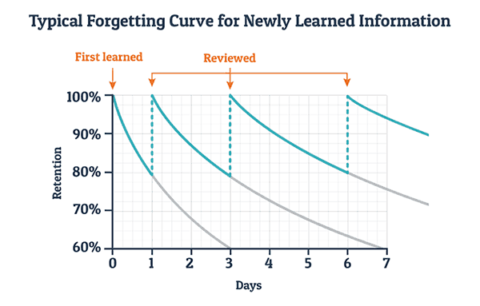
Prior Learning

Slide 6
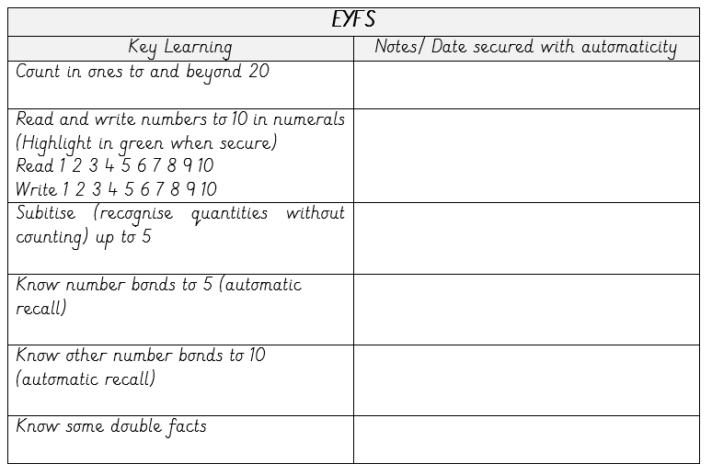
Automaticity

Slide 7

Counting in EYFS
Underpins success in all areas of maths
Count in ones forwards and back to 20
Recognise numbers to 20
Play counting games
Listen out for number pronunciation – teen and ty

Slide 8
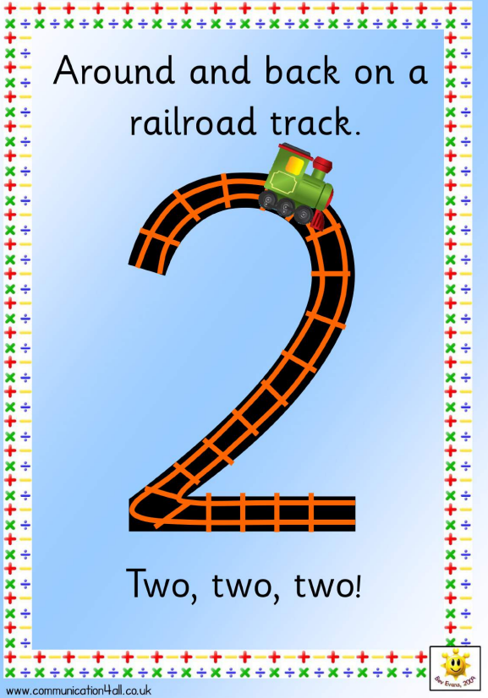
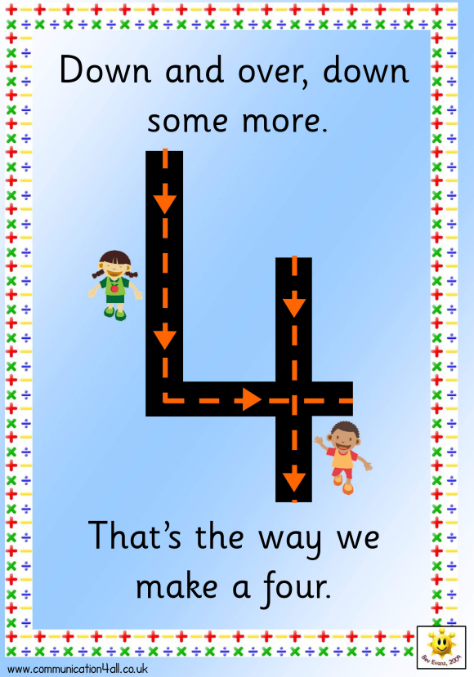
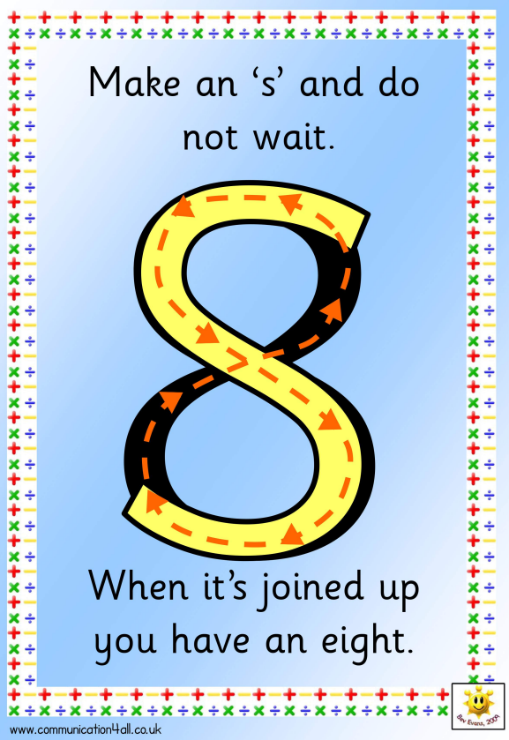
Number recognition
  Number rhymes – formation of numbers
  Flashcard number cards- number recognition
  Drawing numbers with magic pens/ sand/ chalk

Slide 9
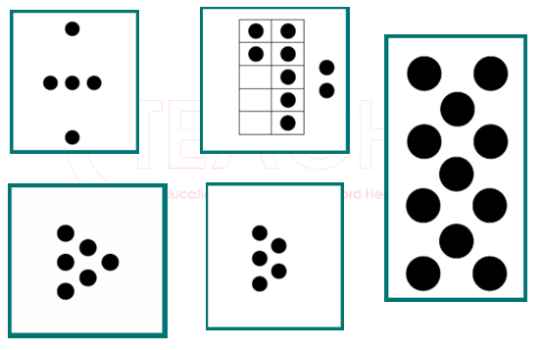
Ability to see an amount of objects and know how many there are without counting.
Pattern spotting, spatial patterns.
Helps develop arithmetic strategies.
Dot images, shown quickly.
Use of fingers and other resources.
Subitising

Slide 10
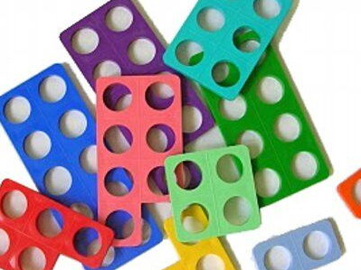

Addition- concrete
Starting with objects:
  Numicon
  Toys
  First, then, now stories
  10s frames and counters
  Counting all / count on from the greatest number
Adding zero
Adding two one digit numbers

Slide 11
Addition- pictoral
Then encouraging pictorial representations by drawing objects or crosses

Slide 12
Addition- abstract
Progressing to abstract calculations – mentally:
  Head and fingers
  Doubles
  Number bonds to 5 (10 after Christmas)

Slide 13
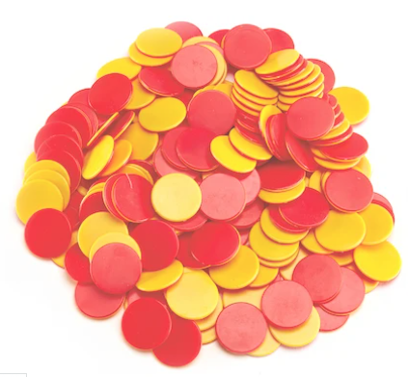
Subtraction- concrete
With objects:
  Numicon
  Toys
  10s frames and counters
  First, then, now or bus stories
Subtracting zero
Subtracting a one digit number from another one digit number

Slide 14
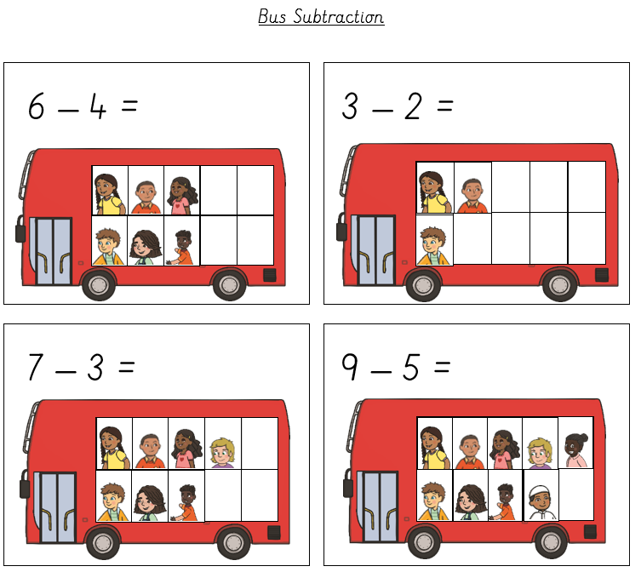
Subtraction- pictoral
Drawing objects (the whole) and crossing off parts
Crosses, pictures

Slide 15
Subtraction - abstract
Progressing to abstract calculations – mentally:
  Counting back from the greatest number
  Head and fingers
  Number bonds to 5

Slide 16
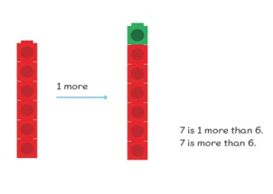
Number
Exploring odd and even numbers
Ordering non consecutive numbers
Sharing
Finding half of objects and amounts
Doubling sets of objects
Learning number facts and using them
1 more and 1 less facts

Slide 17
Transition to Year 1
Lesson format (counting, fluency, task)
Still using concrete resources
Progressive and sequenced to build on learning.
Automaticity

Slide 18
How could you help at home?
Cbeebies clips 'Numberblocks‘
Practise counting up and back from 20
Practise writing numbers to pick up number reversals
Learning news/ Home learning challenges – coming soon!
Real life maths

Slide 19
Thank you for coming.
If you have any questions, please ask us.

